Slide 1
Network Intrusion Detection: A Comparative Study on Logistic Regression, KNN, and Light Gradient Boosting Machine Learning Techniques
Abdullah
ID: 12-182-0006
Shahriar Islam Shifat
ID: 12-182-0004
Supervisor: Shovan Kumar Paul

Slide 2
TABLE OF CONTENTS
01
Introduction
02
Previous study
03
Methodology
04
Result
05
Discussion
06
Conclusion

Slide 3
Introduction
Network Intrusion Detection.
Importance of Network Intrusion Detection.
Objectives of Our Research.
Techniques Used for Network Intrusion Detection.
Motivation for Our Research.

Slide 4
Previous study
NID using ML and DL approach.
Aimed to get high accuracy and low false alarm rates.
Enhancing the result in the real world.
Limitations of the existing system.

Slide 5
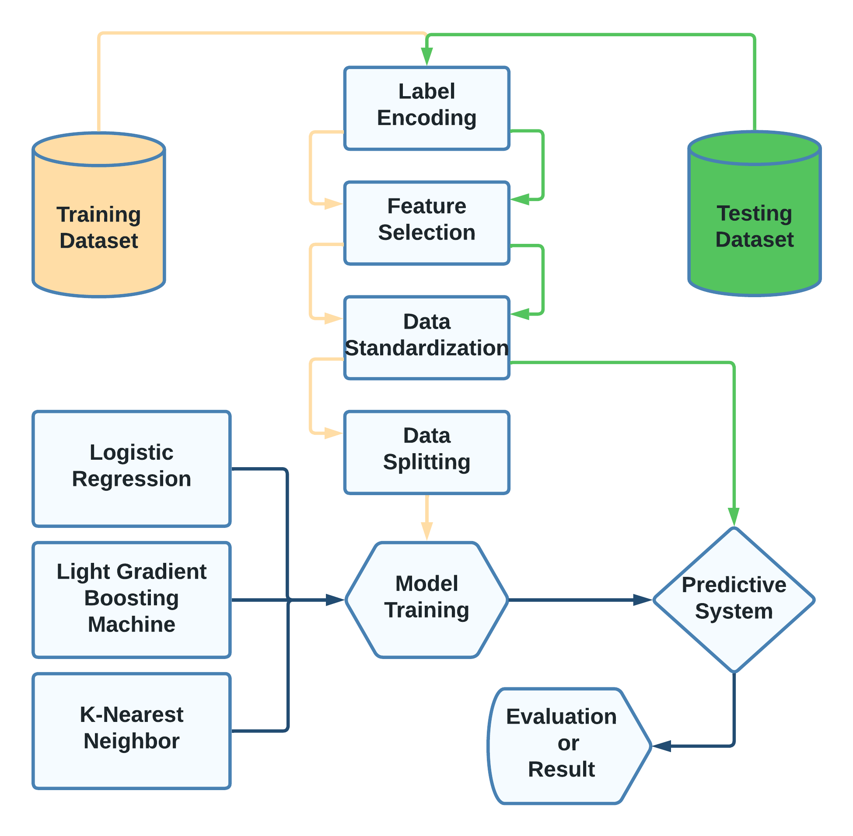
Methodology

Slide 6
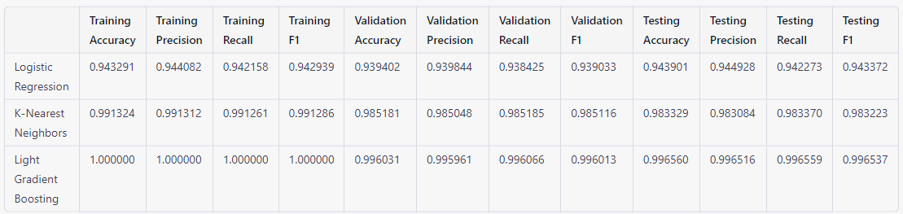
Result

Slide 7
Discussion
Evaluation
Future Research
Ethical Considerations
Comparison with existing systems
1
2
3
4

Slide 8
Conclusion
Develop NID using KDD CUP 99 dataset.
Compared to three machine learning algorithms.
Get the highest accuracy of 99.65% on LGBM.
Importance of feature selection.
Limitation of our study.
Future Work.

Slide 9
Thank You

